Slide 1
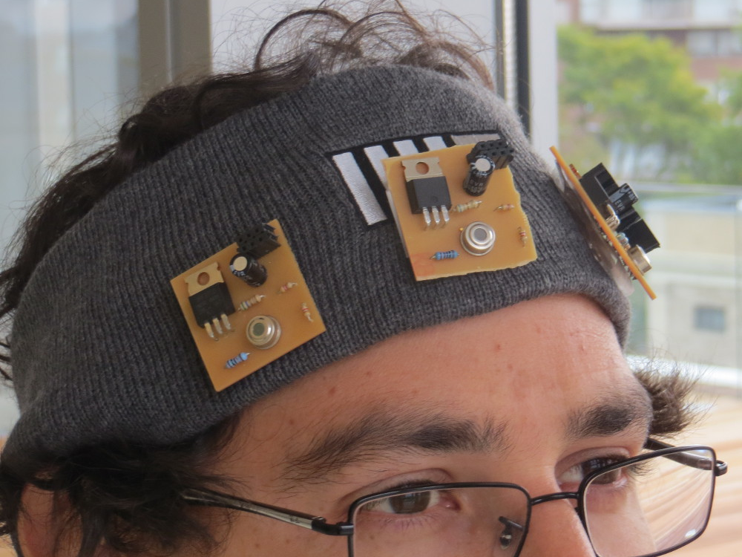
Digital Synesthesia
Using Mobile Technology to Interact with Our World
Committee:
V. Michael Bove Jr.
Joseph Paradiso
Kevin Slavin
PhD Proposal By:
Santiago Alfaro

Slide 2
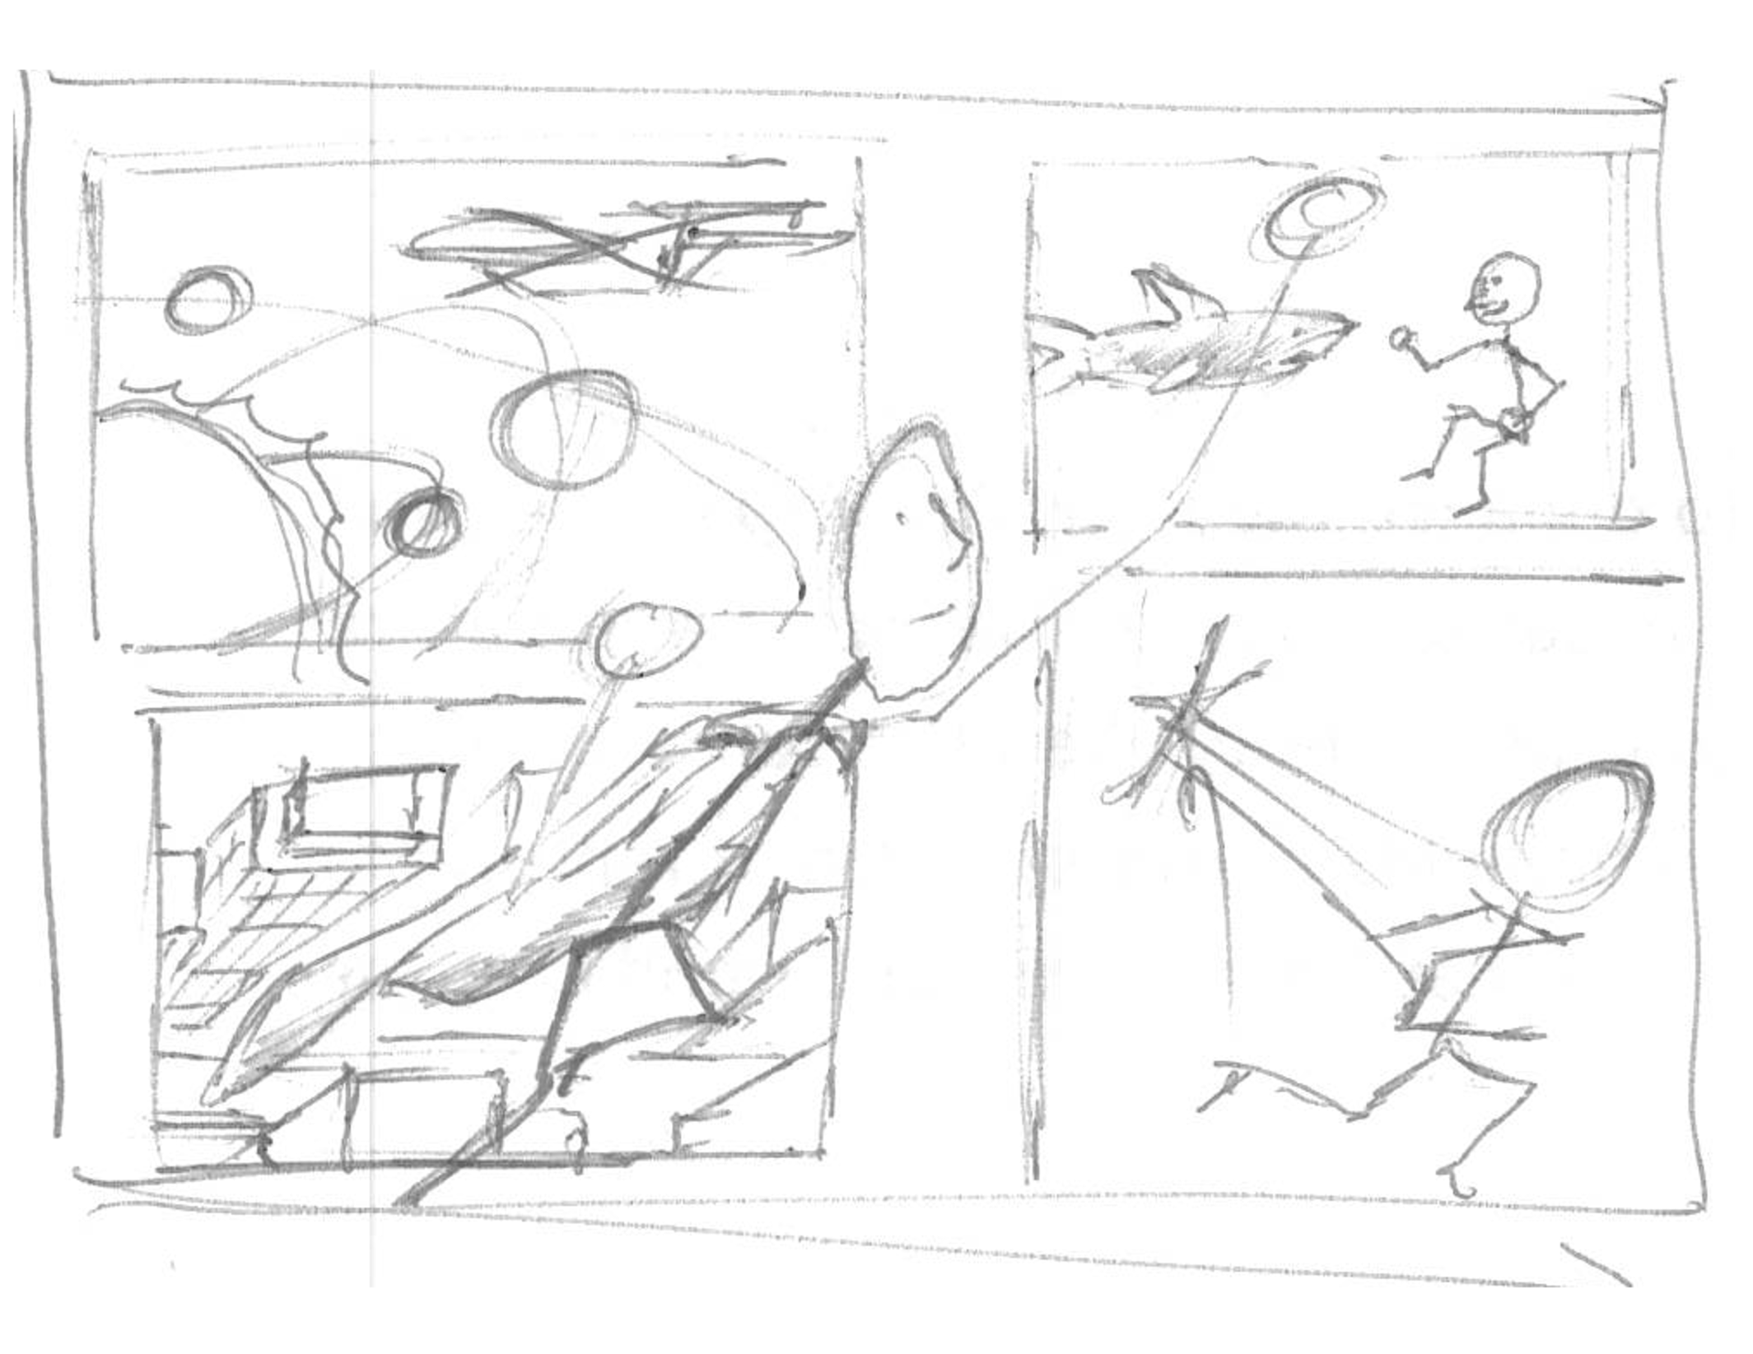
Humans have dreamt of going past our physical capabilities like…
… Breathing under water…
… Speed…
… going to space…
… or flying.
Notes:
Intro: Dreams:
Dreams - breathing under water – speed – space – flying.

Slide 3
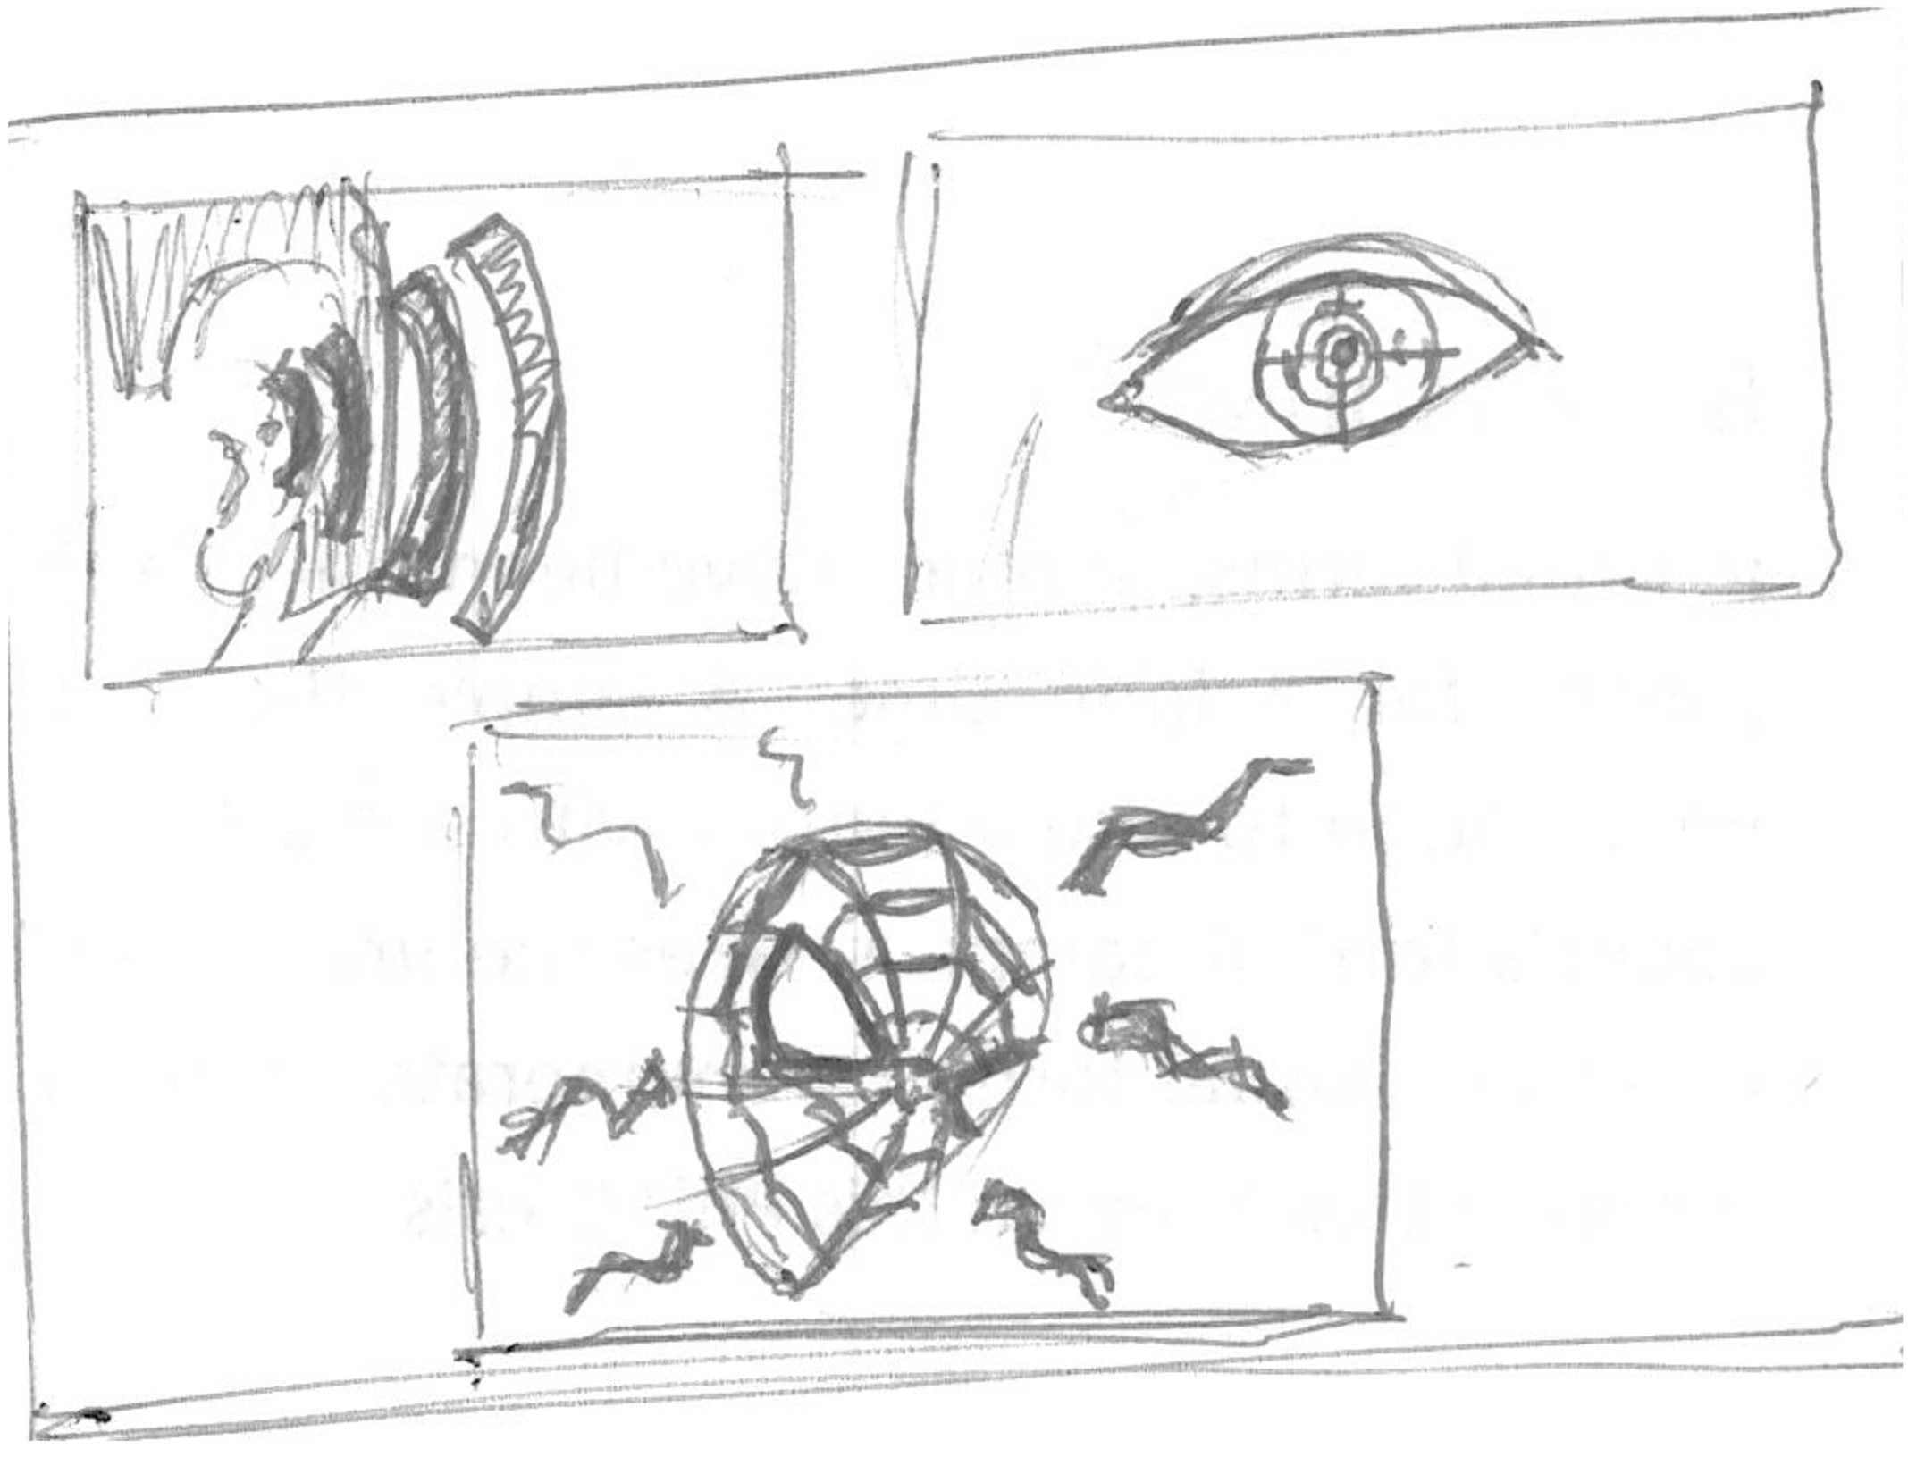
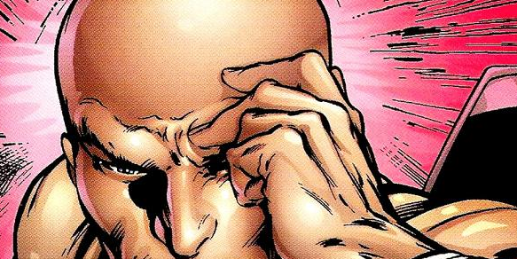
Other dreams are about our senses…
Some are about senses we don’t possess
… sight…
… spidey sense…
… hearing…
… the quickening.
Notes:
Intro: Super Heroes
Senses – Sight – sound – porf X – Spidey - Quickening

Slide 4
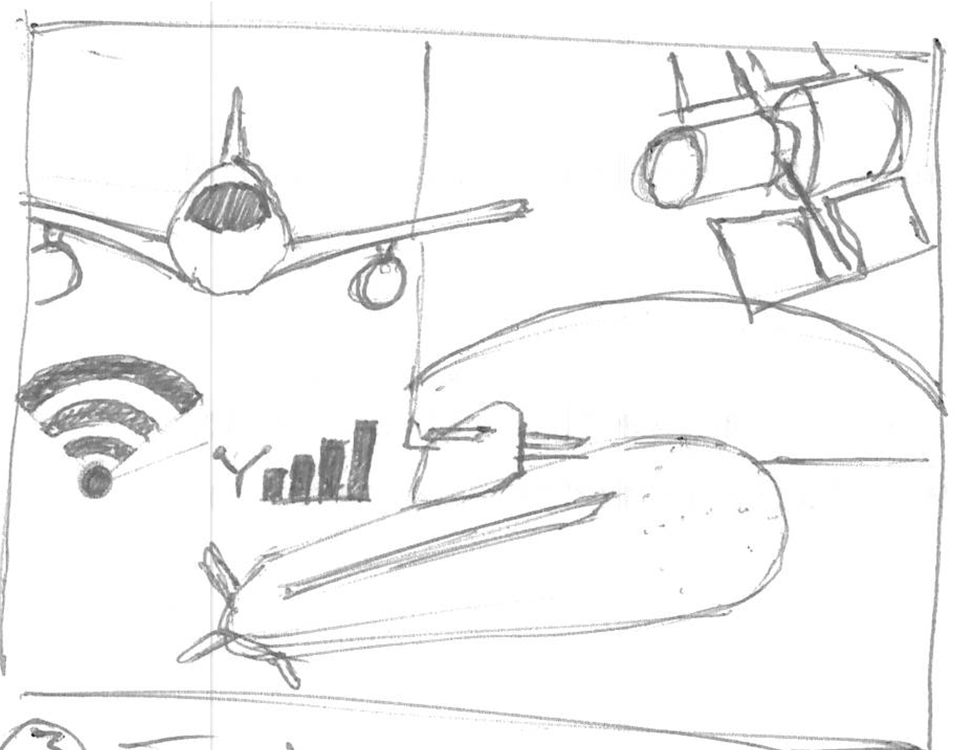
WE have reached some dreams
AND UNDERSTANDING OUR WORLD
With technology
Notes:
Intro: Technology

Slide 5
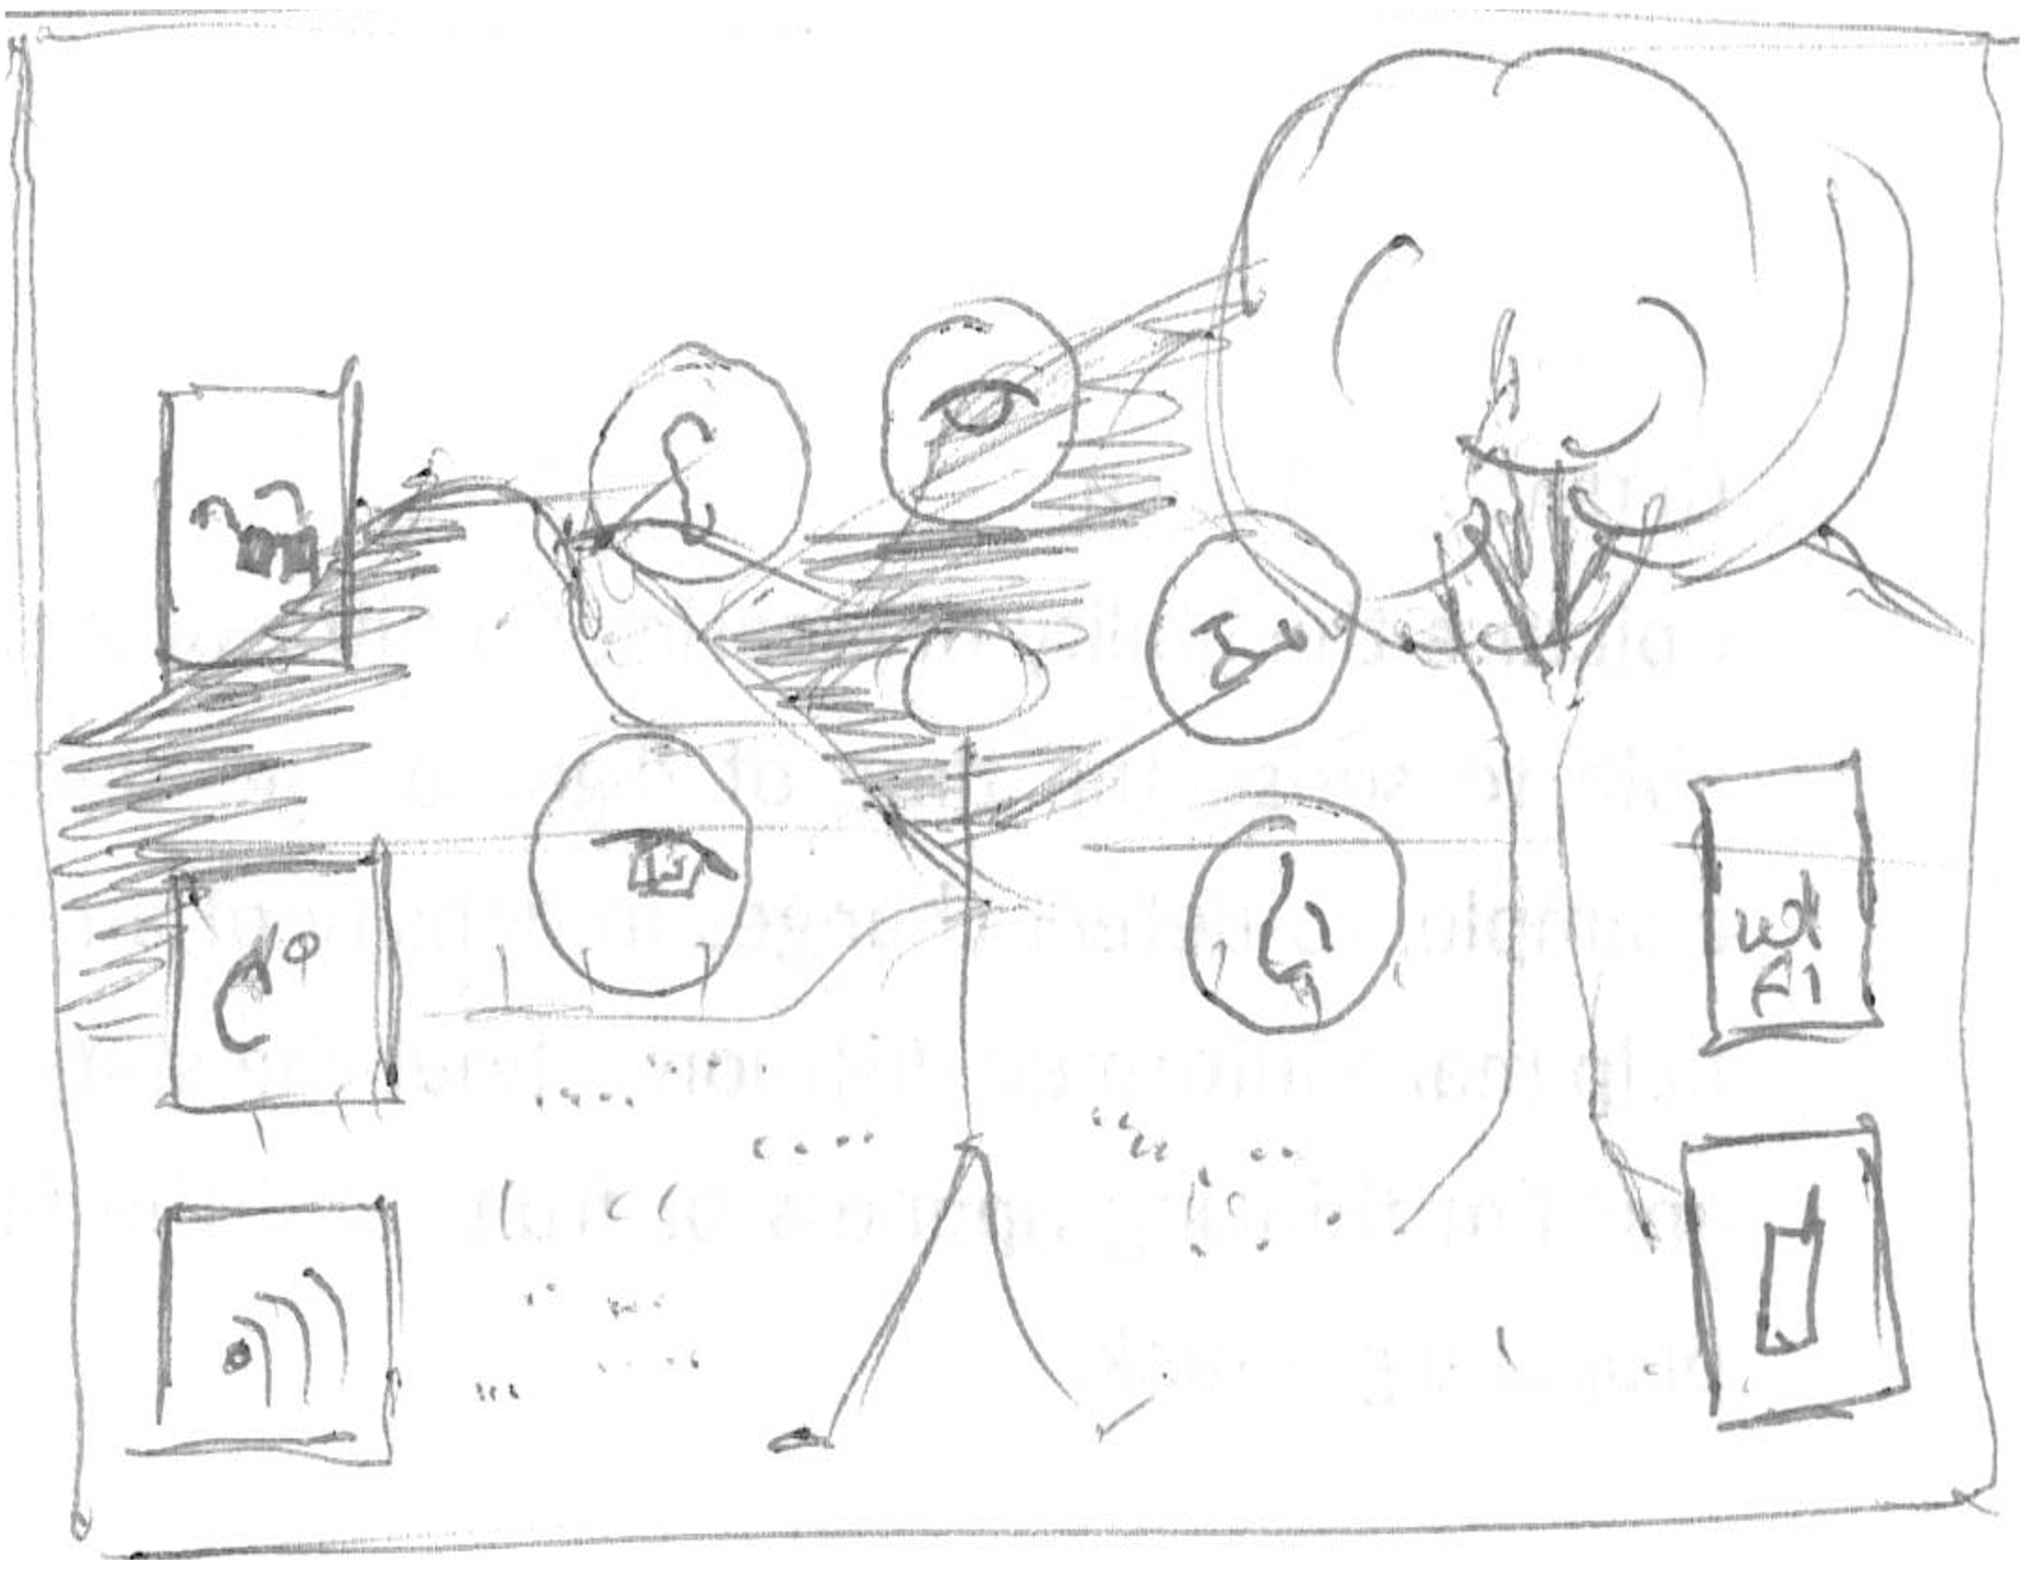
Intro - what
More info than can be sensed, in the world

Slide 6
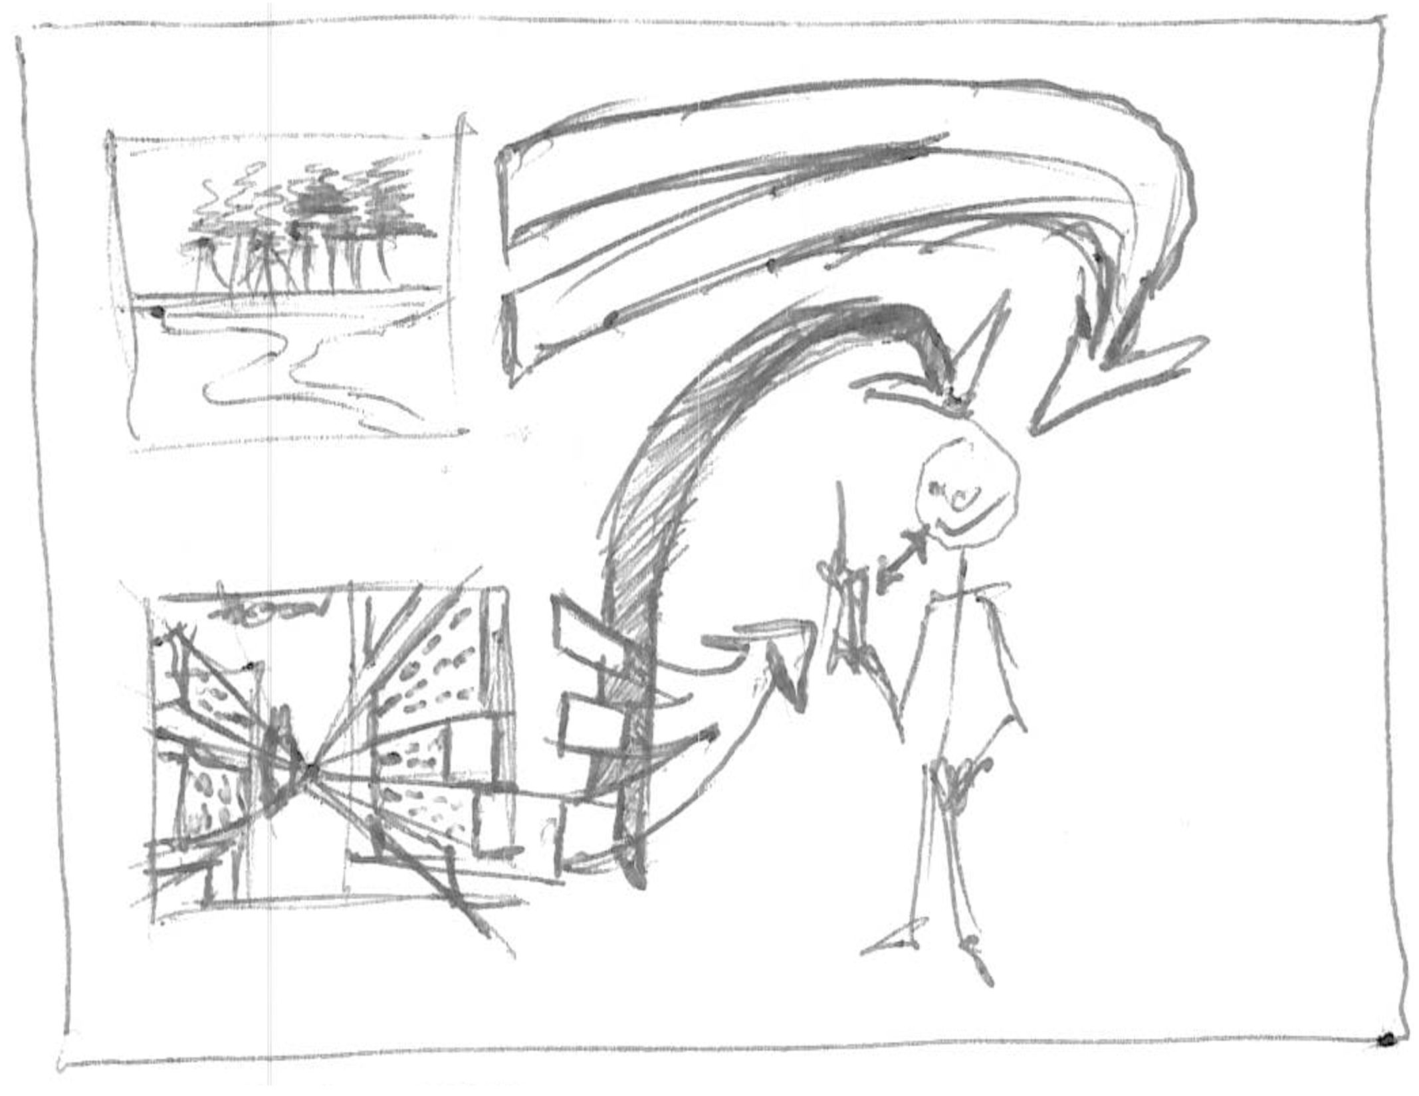
Intro - what
Mobile device a translator

Slide 7
Intro - why
Physical connection to the world by-pass device and cognition.

Slide 8
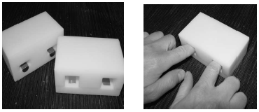
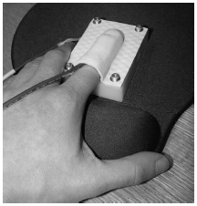
Background - Interface
Thermal

Slide 9
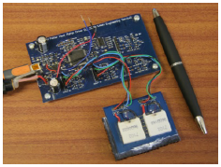
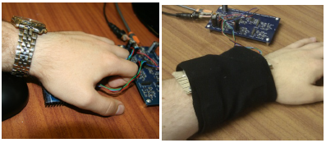
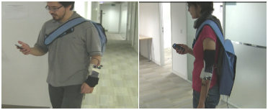
Background - Interface
Thermal

Slide 10
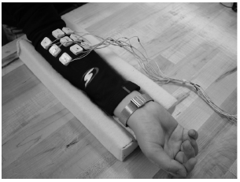
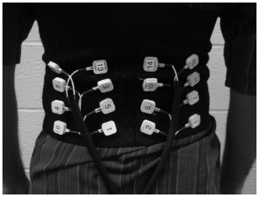
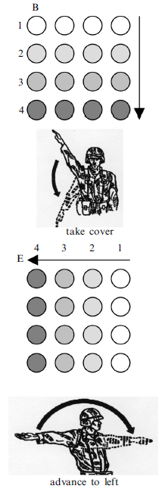
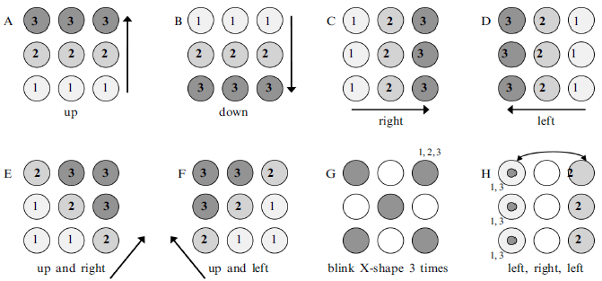
Background - Interface
Vibrotactile – Pattern Recognition

Slide 11
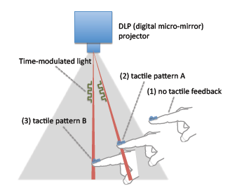
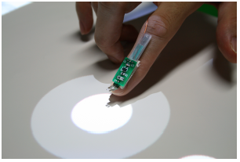
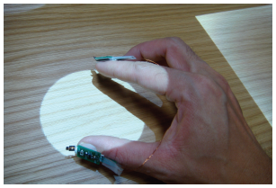
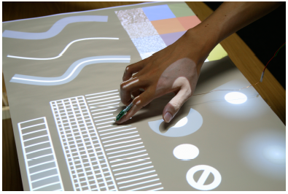
Background - Interface
Vibrotactile – Senseable Rays

Slide 12
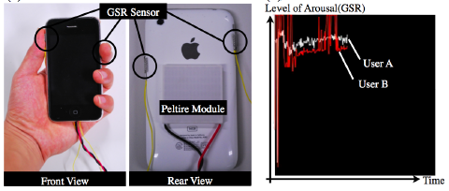
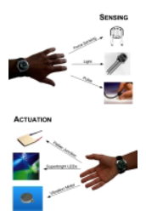
Background - INterface
pressages
Mobile communications

Slide 13
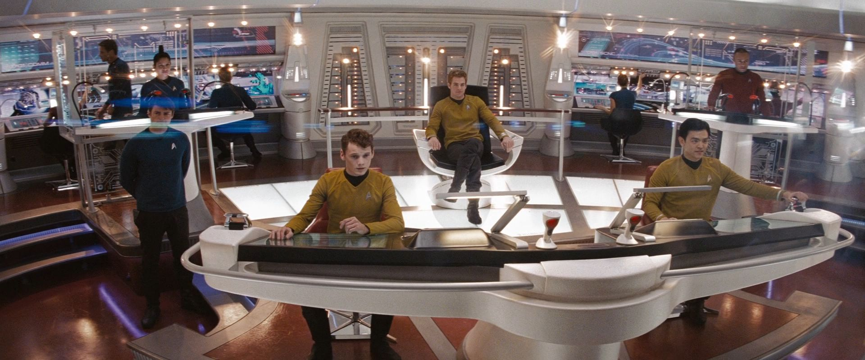
Background - INterface
Situational awareness

Slide 14
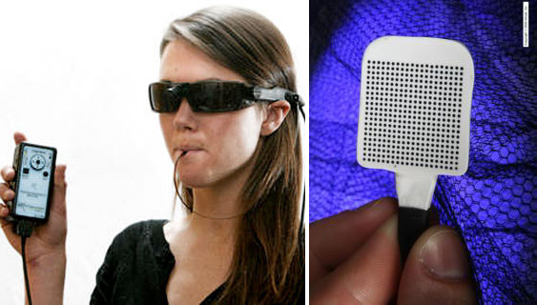
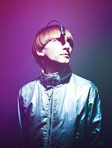
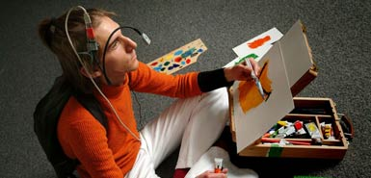
Background – senses
Sensory substitution

Slide 15
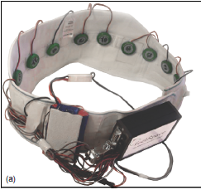
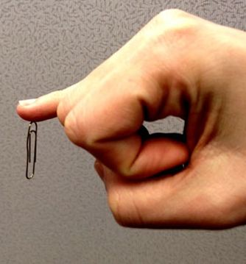
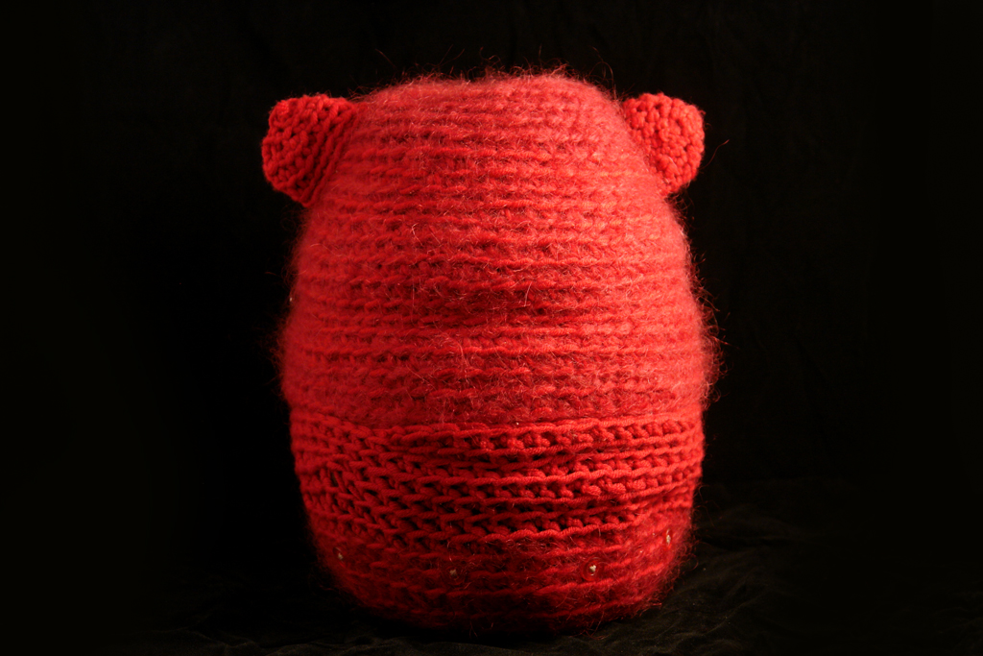
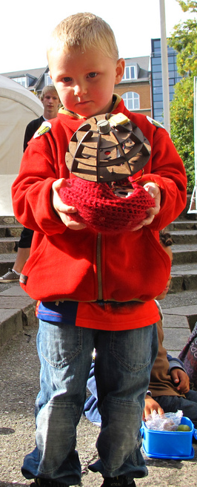
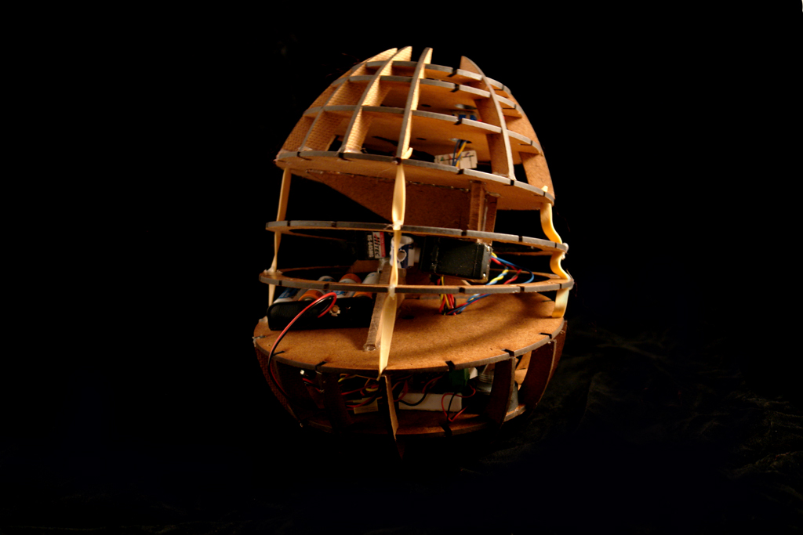
Background senses
New Senses

Slide 16
Background
Neuroplasticity

Slide 17
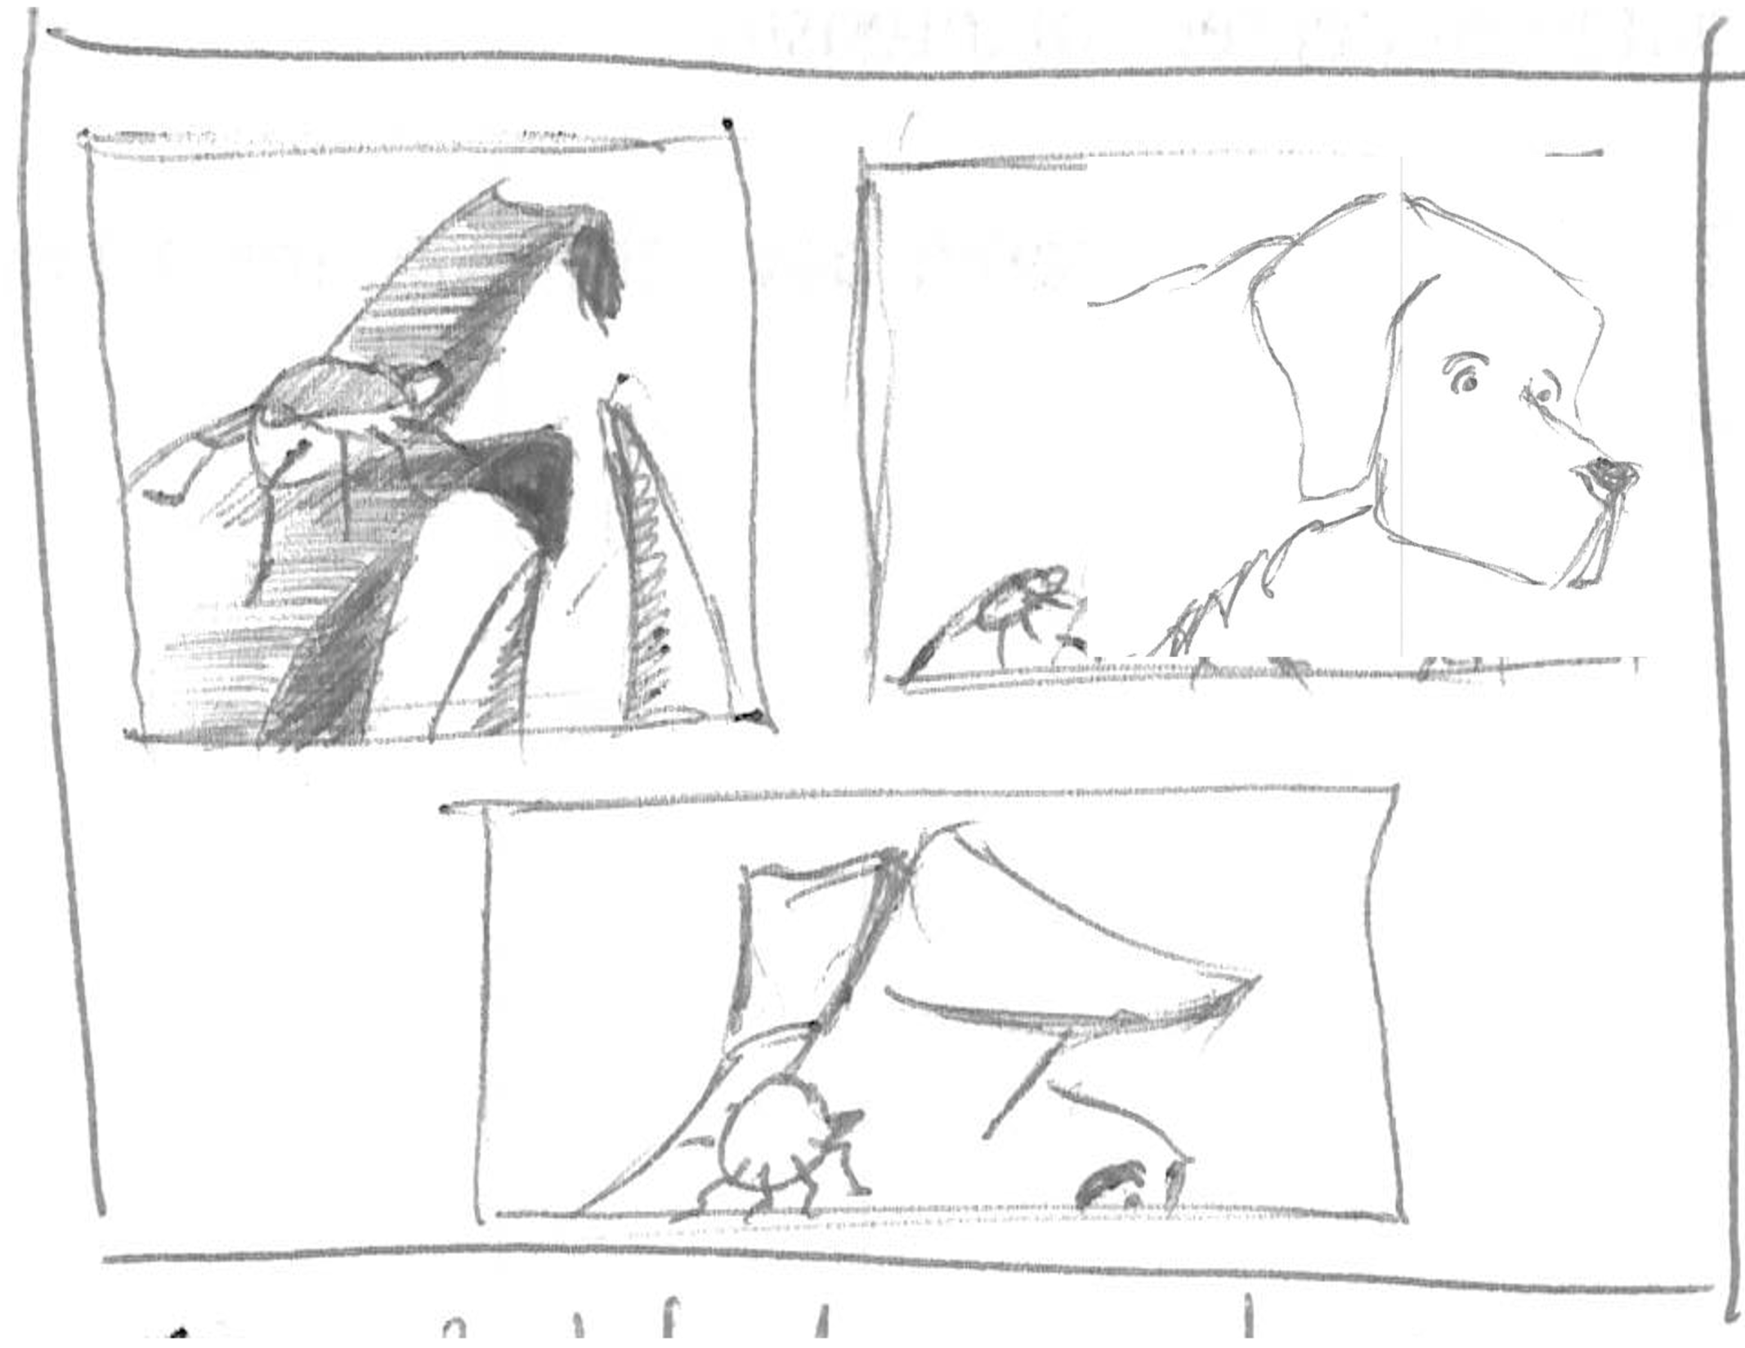
Digital Synesthesia
Uexkull

Slide 18
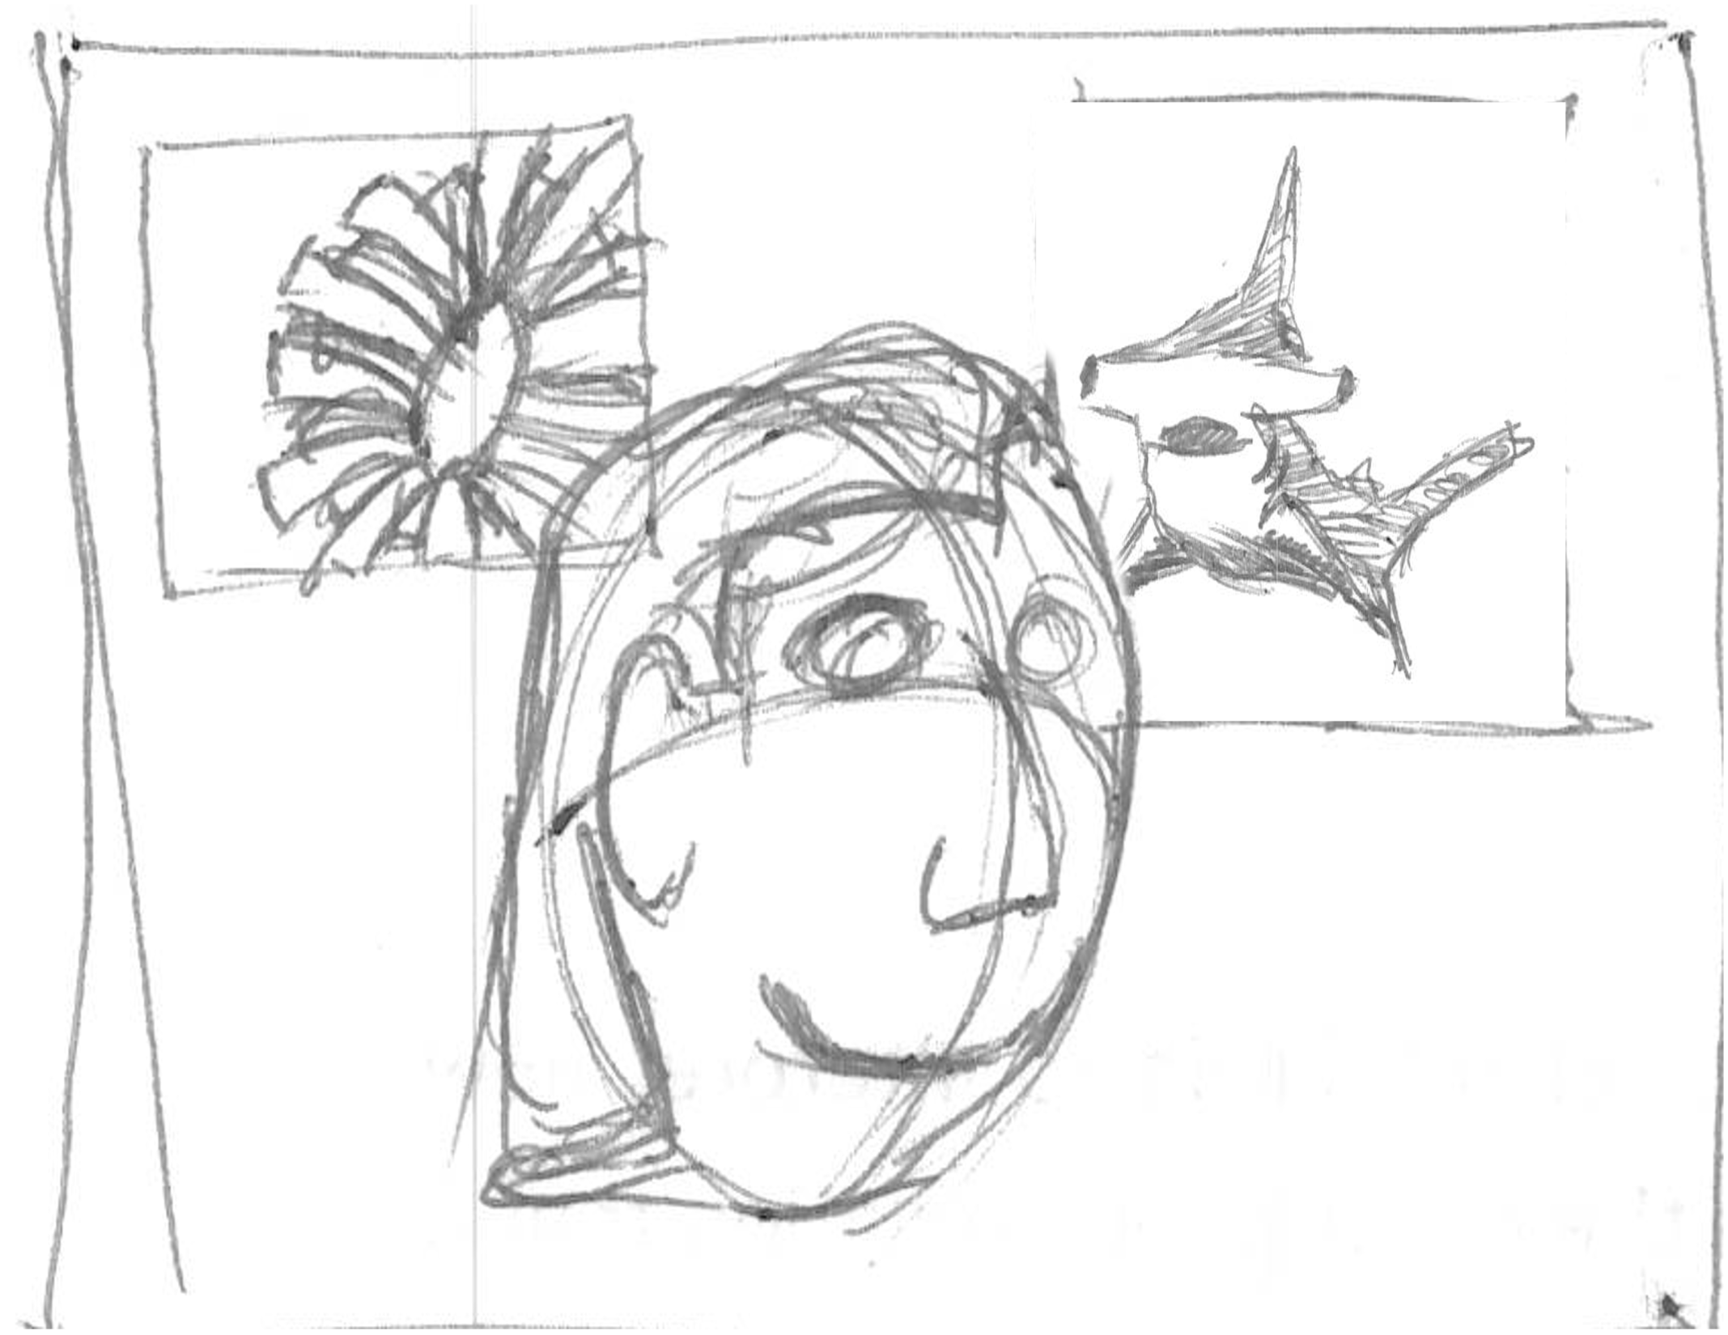
Digital Synesthesia
Nth sense

Slide 19
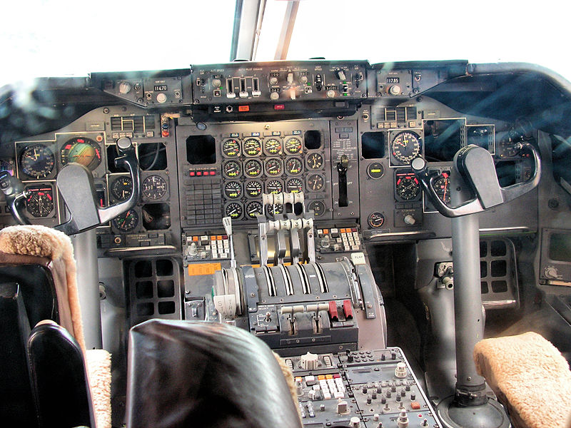
Digital Synesthesia
Cognitive Load

Slide 20
Digital Synesthesia
Personal interpretation

Slide 21
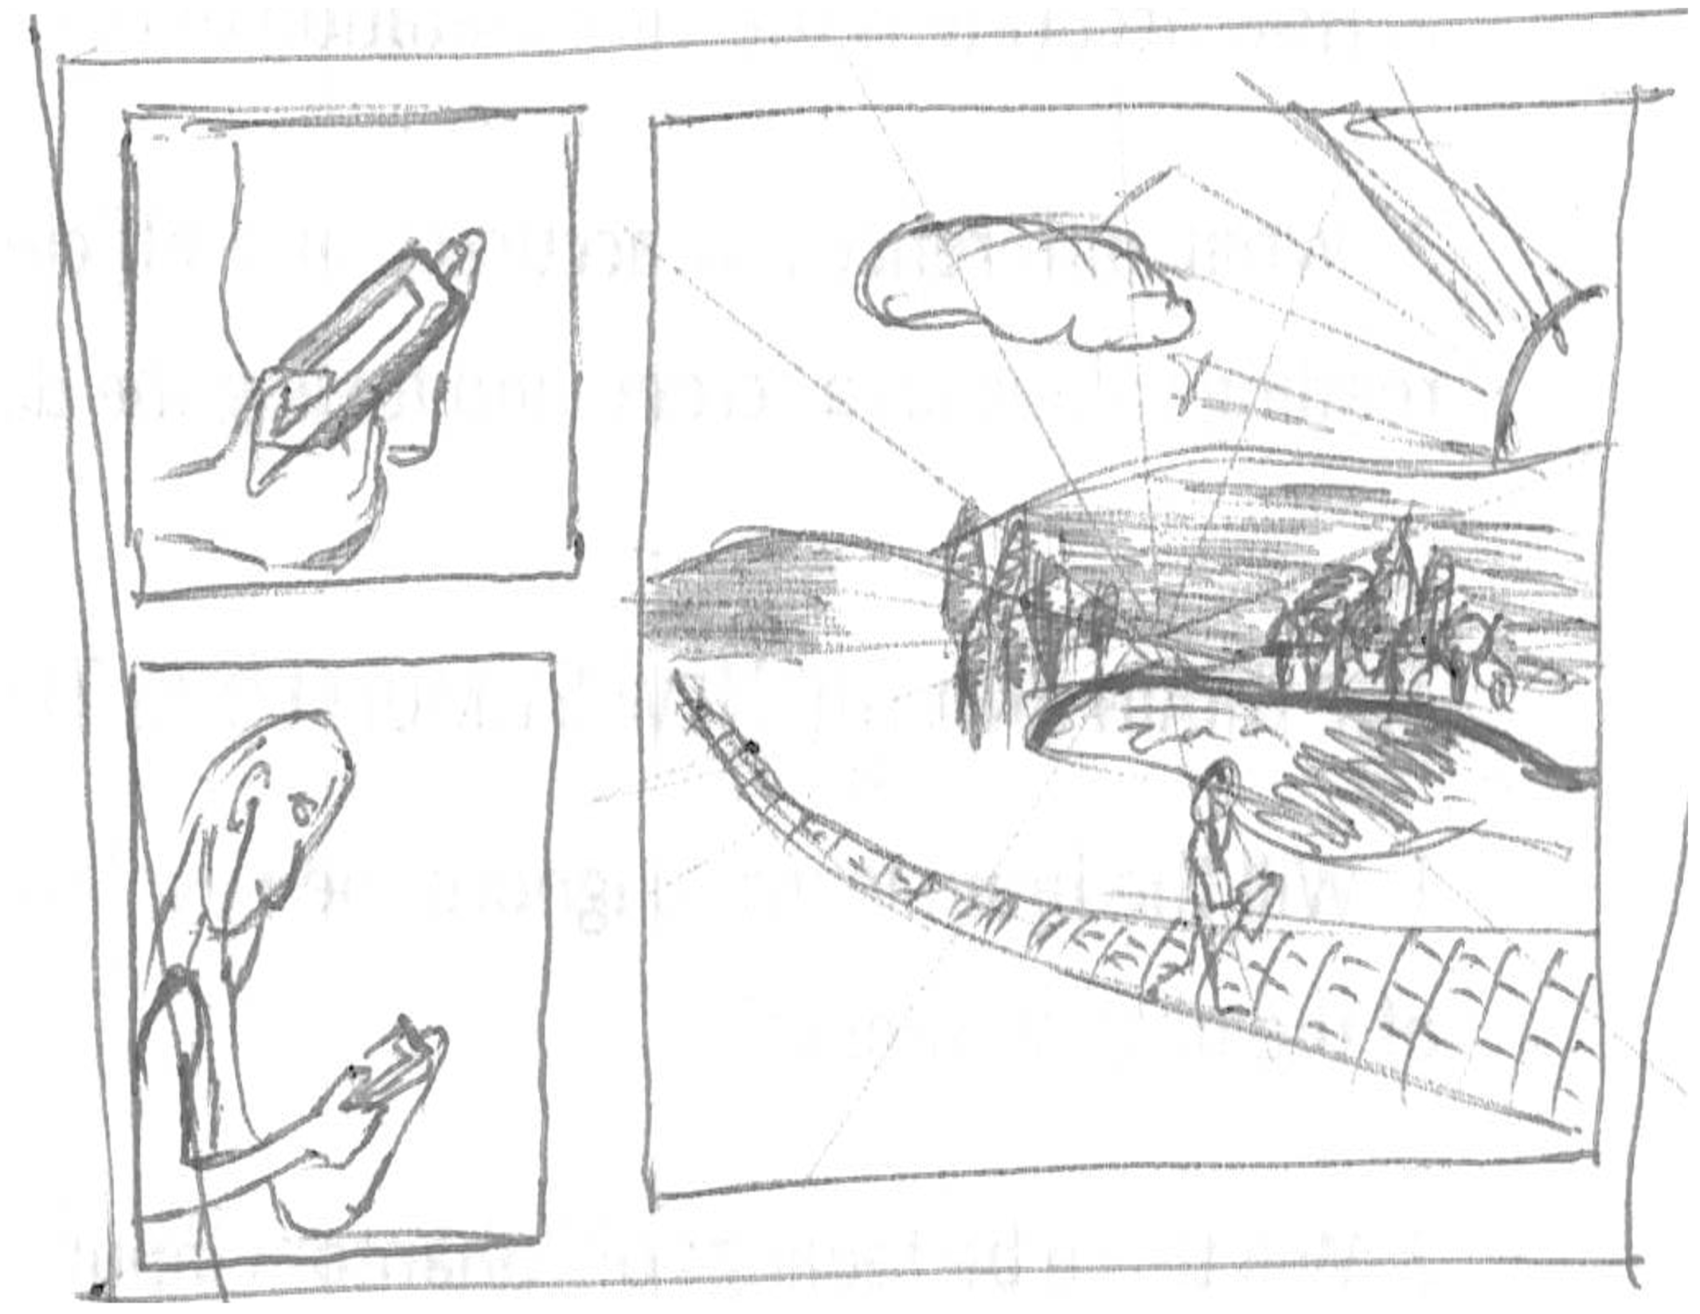
Digital Synesthesia
Immersion in the world

Slide 22
Research Questions
Discreet and Continuous Data

Slide 23
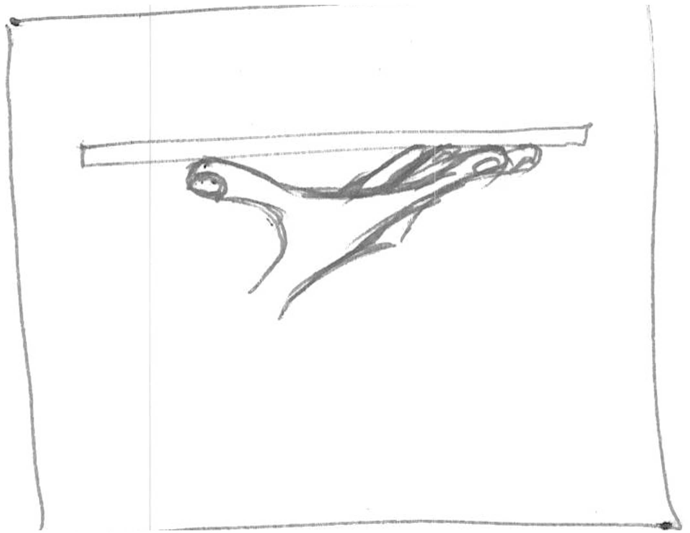
Research Questions
Sensory Augmentation

Slide 24
Research Questions
Sensory Substitution

Slide 25

Research PLan
Stage 1

Slide 26
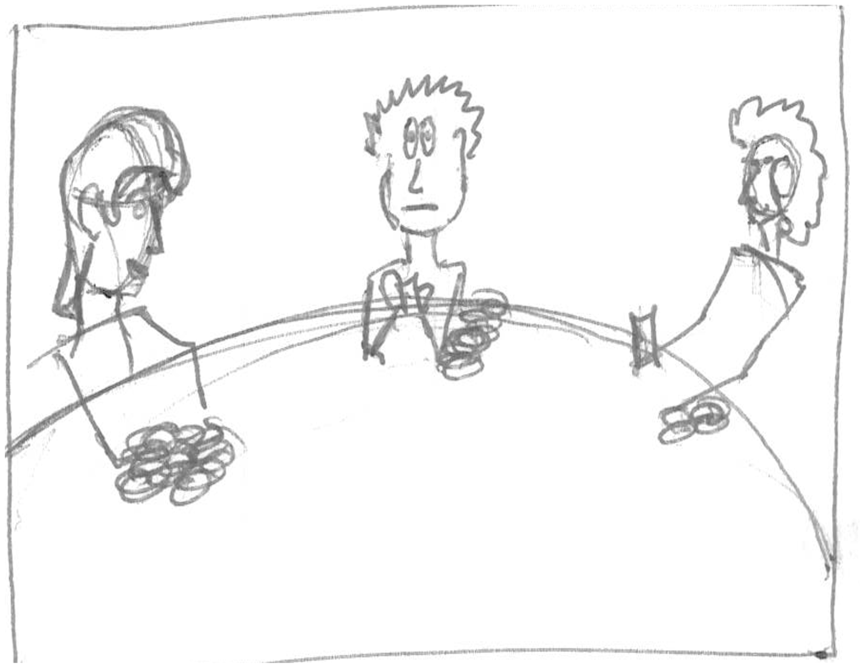
Research Questions
New Senses

Slide 27
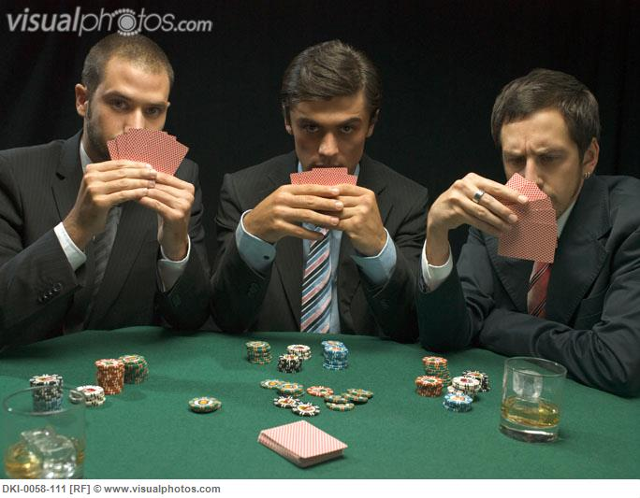
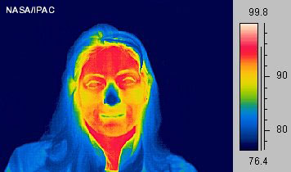
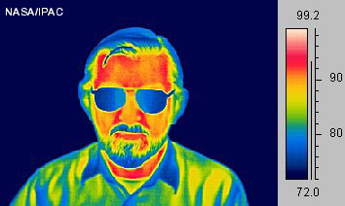
Research plan
Stage 2

Slide 28
Research Questions
New Stimuli

Slide 29
Research Questions
Escaping Visual

Slide 30
Research Questions
Human Development

Slide 31
Research Plan
Stage 3

Slide 32
Research Questions
Design thinking

Slide 33
Research Plan
Stage 4

Slide 34
Timeline

Slide 35
Conclusion

Slide 36
Thankyou
Questions.

